Slide 1
TIME SERIES ANALYSIS

Slide 2
CONTENTS
Bit of Revision
More on AR, MA
Exploring new forecasting models: ARIMA SARIMA
Hands-on Airline Passengers
Exercise on purchase transactions
Facebook’s Prophet Model for forecasting

Slide 3
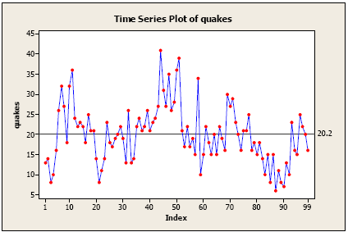
Bit of Revision

Slide 4
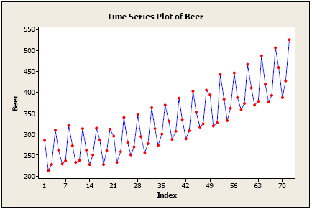
Bit of Revision

Slide 5
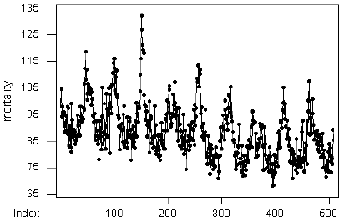
Bit of Revision

Slide 6
BIT OF REVISION
Time series definition, examples and other basics
Time series components
Stationarity:
What does stationarity mean in Time series analysis?
What’s the need for stationarity?
How to check for stationarity?
Ways to Stationarize
Models for forecasting
AR
MA

Slide 7
MORE ON AR, MA
Why do you think we don’t use regression for timeseries analysis?
What are the differences between regression and timeseries data?

Slide 8
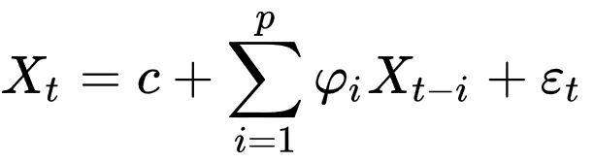
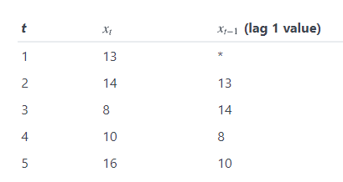
AR

Slide 9
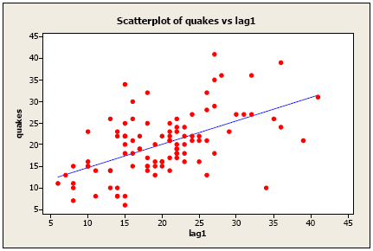
AR

Slide 10
MA
moving-average model is conceptually a linear regression of the current value of the series against current and previous (observed) white noise error terms or random shocks.

Slide 11

AUTOREGRESSIVE INTEGRATED MOVING AVERAGE
ARMA = AR + MA
Parameters : ARMA(p,d,q)
p: number of lag observations(calculate using PACF)
q: size of moving window(calculate using ACF)
d: number of times differencing of the series

Slide 12
SEASONAL ARIMA
Extension to ARIMA, supports seasonality
SARIMA(p,d,q)(P,D,Q)m
There are four seasonal elements that are not part of ARIMA that must be configured; they are:
P: Seasonal autoregressive order.
D: Seasonal difference order.
Q: Seasonal moving average order.
m: The number of time steps for a single seasonal period.

Slide 13
3. FITTING MODEL
FBPROPHET
Prophet is a procedure for forecasting time series data based on an additive model where non-linear trends are fit with yearly, weekly, and daily seasonality, plus holiday effects.
It works best with time series that have strong seasonal effects and several seasons of historical data.
Prophet is robust to missing data and shifts in the trend, and typically handles outliers well.
Notes:
13

Slide 14
3. FITTING MODEL
FBPROPHET
We use a decomposable time series model with three main model components: trend, seasonality, and holidays. They are combined in the following equation:
y(t)=g(t)+s(t)+h(t)+εt
g(t): piecewise linear or logistic growth curve for modelling non-periodic changes in time series
s(t): periodic changes (e.g. weekly/yearly seasonality)
h(t): effects of holidays (user provided) with irregular schedules
εt: error term accounts for any unusual changes not accommodated by the model
Notes:
14

